Slide 1
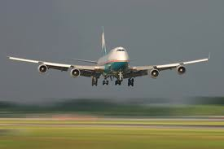
Air Traffic Control School
Case Presentation – Dec. 2, 2010
Stephen Damian, Frank Trudo, Andrew Zuroski

Slide 2
Air Traffic Control School
Training program for future air traffic controllers
Must master scheduling processes to guarantee safe landing sequences for incoming flights
Review given data for 8 incoming flights and determine the most cost effective landing order without crashing any planes

Slide 3
Problem Statement
Using feasible scheduling rules, determine which one is most cost effective
Determine mean flow time, average number of planes, and mean lateness for each sequence
Compare the trade-offs for each scheduling rule
Maintain safety as the primary objective

Slide 4
Data for Incoming Flights

Slide 5
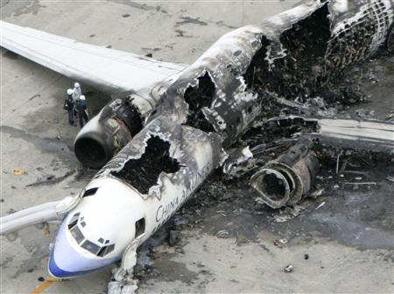
Scheduling methods used in case
MAIN OBJECTIVE: Land planes before flying time is finished causing a crash
Shortest processing time (SPT)- job that has least processing time has highest priority
Highest Cost per minute of flying time- order of sequence is dependent on the cost of a flight when it is flying (the highest cost has priority)
Earliest Due Date (EDD)-job due earliest has top priority
Critical Ratio (CR) -job with the smallest ratio of time remaining until due date to its processing time
Slack Rule- flights landed in order of increasing slack time
Could not use first come/first serve (FCFS), longest due date (LDD)or last come/first serve (LCFS) rules because planes would crash

Slide 6
Scheduling Definitions
Lateness = completion time – due date (+ or -)
Slack = due date – processing time
Critical Ratio = time until due date/processing time
Makespan = length of time to complete batch (land all planes)
Flow time = time a job is complete –time job first available

Slide 7
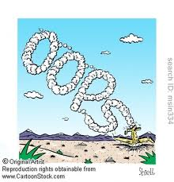
Stick to the Schedule!

Slide 8
Earliest Due Date
Landing Order EDD | Cost per minute ($) | Total Flying Time Limit (min) | Processing Time (minutes) | Flow Time (min) | Lateness | Total Cost Flying ($) | Total Landing Cost ($)
Flight 8076 | 80 | 5 | 1.5 | 1.5 | -3.5 | 0 | 120
Flight 217 | 125 | 8 | 2.75 | 4.25 | -3.75 | 187.5 | 531.25
Flight 101 | 100 | 10 | 2 | 6.25 | -3.75 | 425 | 625
Flight 219 | 200 | 12 | 3.5 | 9.75 | -2.25 | 1250 | 1950
Flight 118 | 150 | 15 | 3 | 12.75 | -2.25 | 1462.5 | 1912.5
Flight 24 | 400 | 16 | 2.5 | 15.25 | -0.75 | 5100 | 6100
Flight 894 | 150 | 19 | 1.75 | 17 | -2 | 2287.5 | 2550
Flight 616 | 300 | 22 | 3.25 | 20.25 | -1.75 | 5100 | 6075
 |  |  | Makespan (minutes) | 20.25
 |  |  | Total time (minutes) | 87
 |  |  | Mean flow time (minutes) | 10.88
 |  |  | Average # of Planes | 4.3
 |  |  | Total Lateness (minutes) |  | -20
 |  |  | Mean Lateness (minutes) |  | -2.5
 |  |  | Total Cost ($) |  |  | 15812.5 | 19863.75

Slide 9
Earliest Due Date
Process Time Total Flow Time
1.5 1.5
217 2.75 4.25
101 2.0 6.25
219 3.5 9.75
118 3.0 12.75
24 2.5 15.25
894 1.75 17
616 3.25 20.25

Slide 10
Shortest Processing Time
Landing Order SPT | Cost per minute ($) | Total Flying Time Limit (min) | Processing Time Minutes (shortest) | Flow Time (minutes) | Lateness (column D-column B) | Cost Flying Total($) | Total Landing Cost ($)
Flight 8076 | 80 | 5 | 1.5 | 1.5 | -3.5 | 0 | 120
Flight 894 | 150 | 19 | 1.75 | 3.25 | -15.75 | 225 | 487.5
Flight 101 | 100 | 10 | 2 | 5.25 | -4.75 | 325 | 525
Flight 24 | 400 | 16 | 2.5 | 7.75 | -8.25 | 2100 | 3100
Flight 217 | 125 | 8 | 2.75 | 10.5 | 2.5 | 968.75 | 1312.5
Flight 219 | 200 | 12 | 3.5 | 14 | 2 | 2100 | 2800
Flight 118 | 150 | 15 | 3 | 17 | 2 | 2100 | 2550
Flight 616 | 300 | 22 | 3.25 | 20.25 | -1.75 | 5100 | 6075
 |  |  | Makespan (minutes) | 20.25
 |  |  | Total Minutes | 79.5
 |  |  | Mean Flow Time (minutes) | 9.94
 |  |  | Average # of planes | 3.93
 |  |  | Total Lateness (minutes) |  | -27.5
 |  |  | Average Lateness (minutes) |  | -3.44
 |  |  | Total Cost ($) |  |  | 12918.75 | 16970

Slide 11
Shortest Processing Time (SPT)
Process Time Total Flow Time
8076 1.5 1.5
894 1.75 3.25
101 2 5.25
24 2.5 7.75
217 2.75 10.5
219 3.5 14
118 3 17
616 3.25 20.25

Slide 12
Analysis of SPT Method
Advantages of using SPT Method
Lowest Mean Flow time
[9.94 minutes]
Lowest average number of jobs
[3.93 jobs]
Disadvantages of using SPT Method
Can not achieve lowest cost
Needs constant monitoring due to planes running out of flying time
Lowest Total Flow time
[79.5 minutes]
Increased job lateness compare to EDD
[ -27.5 minutes]
Minimizes WIP, Maximizes Customer Response Time
Not as efficient as other methods

Slide 13
High Cost/Minute
Landing High Cost/Min | Cost per minute ($) | Total Flying Time Limit (minutes) | Processing Time (minutes) | Flow Time (minutes) | Late (minutes) | Cost Flying Total ($) | Total Landing Cost ($)
Flight 24 | 400 | 16 | 2.5 | 2.5 | -13.5 | 0 | 1000
Flight 894 | 150 | 19 | 1.75 | 4.25 | -14.75 | 375 | 637.5
Flight 8076 | 80 | 5 | 1.5 | 5.75 | 0.75 | 340 | 460
Flight 217 | 125 | 8 | 2.75 | 8.5 | 0.5 | 718.75 | 1062.5
Flight 101 | 100 | 10 | 2 | 10.5 | 0.5 | 850 | 1050
Flight 219 | 200 | 12 | 3.5 | 14 | 2 | 2100 | 2800
Flight 118 | 150 | 15 | 3 | 17 | 2 | 2100 | 2550
Flight 616 | 300 | 22 | 3.25 | 20.25 | -1.75 | 5100 | 6075
 |  | Makespan (minutes) |  | 20.25
 |  | Total Minutes |  | 82.75
 |  | Mean Flow Time (minutes) |  | 10.34
 |  | Average # of Planes |  | 4.09
 |  | Total Lateness (minutes) |  |  | -24.25
 |  | Average Lateness (minutes) |  |  | -3.03
 |  | Total Cost ($) |  |  |  | 11583.75 | 15635

Slide 14
Plane 1 | Plane 2 | Plane 3 | Plane 4 | Plane 5 | Plane 6 | Plane 7 | Plane 8
Flow Time | 4.25 min | 5.75 min | 8.5 min | 10.5 min | 14 min | 17 min | 20.25 min
2.5 min | 1.75 min | 1.5 min | 2.75 min | 2 min | 3.5 min | 3 min | 3.25 min
Flight 24 - 16 min | Flight 894 - 19 min | Flight 8076 5 min | Flight 217 - 8 min | Flight 101 - 10 min | Flight 219 - 12 min | Flight 118 - 15 min | Flight 616 - 22 min
$400/min | $150/min | $80/min | $125/min | $100/min | $200/min | $150/min | $300/min
 | Flight 616 -22 min | Flight 616 - 22 min | Flight 616 - 22 min | Flight 616 - 22 min | Flight 616 - 22 min | Flight 616 - 22 min
 | $300 | $300 | $300 | $300 | $300 | $300
 | 3.25 | 3.25 | 3.25 | 3.25 | 3.25 | 3.25
 | Flight 219 - 12 min | Flight 219 - 12 min | Flight 219 - 12 min | Flight 219 - 12 min
 | $200 | $200 | $200 | $200
 | 3.5 | 3.5 | 3.5 | 3.5
 | Flight 118 - 15 min | Flight 118 - 15 min | Flight 118 - 15 min | Flight 118 - 15 min
 | $150 | $150 | $150 | $150
 | 3 | 3 | 3 | 3
 |  | Flight 217 -8 min
 |  | $125
 |  | 2.75 min
 |  | Flight 101 - 10 min
 |  | $100
 |  | 2

Slide 15
Highest Cost/Minute
Process Time Total Flow Time
2.5 2.5
894 1.75 4.25
8076 1.5 5.75
217 2.75 8.5
101 2.0 10.5
219 3.5 14
118 3.0 17
616 3.25 20.25

Slide 16
Analysis of Highest Cost/Minute Method
Advantages of Highest Cost per/minute
minimized job lateness compared to SPT
[ -24.25 ]
Disadvantages of Highest Cost per/minute
Longer mean flow time results in more WIP
Increased total job flow time, and increased mean job flow time compared to SPT
Increased average number of jobs compared to SPT
Most cost effective method
[ $11,583.75 ]

Slide 17
Critical Ratio (Due Date/Processing Time)
Landing Order - CR | Start | Processing Time (min) | Flow Time (min) | Cost per Minute ($) | Tota Land Cost ($) | Total Cost of Flying ($) | Time until due | Lateness (min)
Flight 217 - 2.91 | 0 | 2.75 | 2.75 | 125 | 343.75 | 0 | 8 | -5.25
Flight 8076 - 3.33 | 2.75 | 1.5 | 4.25 | 80 | 340 | 220 | 5 | -0.75
Flight 219 -3.43 | 4.25 | 3.5 | 7.75 | 200 | 1550 | 850 | 12 | -4.25
Flight 101 - 5 | 7.75 | 2 | 9.75 | 100 | 975 | 775 | 10 | -0.25
Flight 118 - 5 | 9.75 | 3 | 12.75 | 150 | 1912.5 | 1462.5 | 15 | -2.25
Flight 24 -6.4 | 12.75 | 2.5 | 15.25 | 400 | 6100 | 5100 | 16 | -0.75
Flight 616 -6.77 | 15.25 | 3.25 | 18.5 | 300 | 5550 | 4575 | 22 | -3.5
Flight 894 - 10.86 | 18.5 | 1.75 | 20.25 | 150 | 3037.5 | 2775 | 19 | 1.25
 |  |  |  | Total Cost ($) | 19808.75 | 15757.5
 |  | Total Flow Time (min) | 91.25 |  |  |  | TOTAL | -15.75
 |  | Mean Flow Time (min) | 11.4 |  |  |  | Average Lateness | -1.96875
 |  | Average # of Jobs | 4.50617284

Slide 18
Slack Time (mins) = EDD
Landing Order - Slack (mins) | Start | Processing Time (min) | Flow Time (min) | Cost per Minute ($) | Tota lLand Cost ($) | Total Cost Flying ($) | Time until due (mins) | Lateness (mins)
Flight 8076 - 3.5 | 0 | 1.5 | 1.5 | 80 | 120 | 0 | 5 | -3.5
Flight 217 - 5.25 | 1.5 | 2.75 | 4.25 | 125 | 531.25 | 187.5 | 8 | -3.75
Flight 101 - 8 | 4.25 | 2 | 6.25 | 100 | 625 | 425 | 10 | -3.75
Flight 219 - 8.5 | 6.25 | 3.5 | 9.75 | 200 | 1950 | 1250 | 12 | -2.25
Flight 118 - 12 | 9.75 | 3 | 12.75 | 150 | 1912.5 | 1462.5 | 15 | -2.25
Flight 24 - 13.5 | 12.75 | 2.5 | 15.25 | 400 | 6100 | 5100 | 16 | -0.75
Flight 894 - 17.25 | 15.25 | 1.75 | 17 | 150 | 2550 | 2287.5 | 19 | -2
Flight 616 - 18.75 | 17 | 3.25 | 20.25 | 300 | 6075 | 5100 | 22 | -1.75
 |  |  |  | Total Cost ($) | 19863.75 | 15812.5
 |  | Totol Flow Time (min) | 87 |  |  |  | TOTAL | -20
 |  | Mean Flow Time (min) | 10.875 |  |  |  | Average Lateness | -2.5
 |  | Average # of jobs | 4.296296296

Slide 19
Total Slack Cost
Landing Order - Slack Cost | Start | Processing Time (min) | Flow Time (min) | Cost Per Minute ($) | Total Land Cost ($) | Total Cost of Flying ($) | Time until due (mins) | Lateness (mins)
Flight 24 - $5400 | 0 | 2.5 | 2.5 | 400 | 1000 | 0 | 16 | -13.5
Flight 894 - $2587.50 | 2.5 | 1.75 | 4.25 | 150 | 637.5 | 375 | 19 | -14.75
Flight 8076 - $280 | 4.25 | 1.5 | 5.75 | 80 | 460 | 340 | 5 | 0.75
Flight 101 -$800 | 5.75 | 2 | 7.75 | 100 | 775 | 575 | 10 | -2.25
Flight 217 - $656.25 | 7.75 | 2.75 | 10.5 | 125 | 1312.5 | 968.75 | 8 | 2.5
Flight 219 - $1700 | 10.5 | 3.5 | 14 | 200 | 2800 | 2100 | 12 | 2
Flight 118 - $1800 | 14 | 3 | 17 | 150 | 2550 | 2100 | 15 | 2
Flight 616 - $5625 | 17 | 3.25 | 20.25 | 300 | 6075 | 5100 | 22 | -1.75
 |  |  |  | Total Cost ($) | 15610 | 11558.75
 |  | Total Flow Time (min) | 82 |  |  |  | TOTAL | -25
 |  | Mean Flow Time (min) | 10.25 |  |  |  | Average Lateness | -3.125
 |  | Average # of jobs | 4.049382716

Slide 20
Total Slack Cost – Alternatives
Flow Time | 3.25 | 5 | 6.5 | 9.25 | 11.25 | 14.75 | 17.75 | Column1
Processing Time | 3.25 | 1.75 | 1.5 | 2.75 | 2 | 3.5 | 3
 | Flight 616 | Flight 894 | Flight 8076 | Flight 217 | Flight 101 | Flight 219 | Flight 118 | Flight 24 Due 16 minutes
 | $5,625 | $2,587.50 | $280 | $656 | $800 | $1,700 | $1,800
 | Due 22 min | Due 19 min | Due 5 min | Due 8 min | Due 10 min | Due 12 min | Due 15 min
Flow Time | 3.25 | 4.75 | 7.25 | 10 | 12 | 15.5
Processing Time | 3.25 | 1.5 | 2.5 | 2.75 | 2 | 3.5
 | Flight 616 | Flght 8076 | Flight 24 | Flight 217 | Flight 101 | Flight 219 | Flight 118 Due 15 minutes
 | $5,625 | $280 | $5,400 | $656.25 | $800 | $1,700
 | Due 22 min | Due 5 min | Due 16 min | Due 8 min | Due 10 min | Due 12 min
Flow Time | 3.25 | 4.75 | 7.75 | 10.5
Processing Time | 3.25 | 1.5 | 3 | 2.75
 | Flight 616 | Flight 8076 | Flight 118 | Flight 217 | Flight 101 Due 10 min
 | $5,625 | $280 | $1,800 | $656
 | Due 22 min | Due 5 min | Due 15 min | Due 8 min
Flow Time | 3.25 | 4.75 | 6.5 | 9.25 | 11.25 | 14.75 | 17.75
Processing Time | 3.25 | 1.5 | 1.75 | 2.75 | 2 | 3.5 | 3
 | Flight 616 | Flight 8076 | Flight 894 | Flight 217 | Flight 101 | Flight 219 | Flight 118 | Flight 24 Due 16 minutes
 | $5,625 | $280 | $2,587.50 | $656 | $800 | $1,700 | $1,800
 | Due 22 min | Due 5 min | Due 19 min | Due 8 min | Due 10 min | Due 12 min | Due 15 min

Slide 21
Sequence for Slack Cost
Process Time Total Flow Time
24 2.5 2.5
894 1.75 4.25
8076 1.5 5.75
101 2.0 7.75
217 2.75 10.5
219 3.5 14
118 3 17
616 3.25 20.25

Slide 24
Conclusions
Earliest Due Date – minimizes lateness, no adjustments to avoid crashes
Shortest Processing Time – lowest mean flow time and average # of planes in process
Slack Cost – modified sequence is the most cost effective in this case

Slide 25
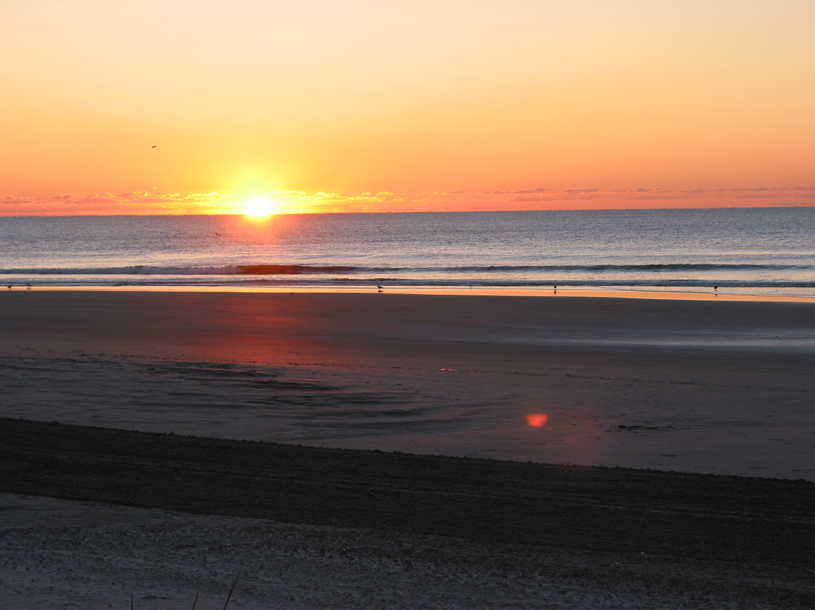
Thank you and have a safe flight!

