Slide 1
Chapter 3 Linear Programming: Sensitivity Analysis and Interpretation of Solution
Introduction to Sensitivity Analysis
Graphical Sensitivity Analysis
Sensitivity Analysis: Computer Solution
Limitations of Classical Sensitivity Analysis

Slide 2
Introduction to Sensitivity Analysis
In the previous chapter we discussed:
objective function value
values of the decision variables
slack/surplus
In this chapter we will discuss:
changes in the coefficients of the objective function
changes in the right-hand side value of a constraint
reduced costs

Slide 3
Introduction to Sensitivity Analysis
Sensitivity analysis (or post-optimality analysis) is used to determine how the optimal solution is affected by changes, within specified ranges, in:
the objective function coefficients
the right-hand side (RHS) values
Sensitivity analysis is important to a manager who must operate in a dynamic environment with imprecise estimates of the coefficients.
Sensitivity analysis allows a manager to ask certain what-if questions about the problem.

Slide 4
Graphical Sensitivity Analysis
For LP problems with two decision variables, graphical solution methods can be used to perform sensitivity analysis on
the objective function coefficients, and
the right-hand-side values for the constraints.
XYZ, Inc. LP Formulation
Max Z = 5x₁ + 7x₂
s.t. x₁ < 6 (1)
2x₁ + 3x₂ < 19 (2)
x₁ + x₂ < 8 (3)
x₁, x₂ > 0

Slide 5
Example 1
Graphical Solution
x₂
x₁ + x₂ < 8 (3)
8
7
6
5
4
3
2
1
Max 5x₁ + 7x₂
x₁ < 6 (1)
Optimal Solution:
x₁ = 5, x₂ = 3, Z= 46
2x₁ + 3x₂ < 19 (2)
x₁
1 2 3 4 5 6 7 8 9 10

Slide 6
Objective Function Coefficients
The range of optimality for each coefficient provides the range of values over which the values of decision variables will remain optimal (i.e., the same).
Note that the objective function value will change if the coefficient/s of the decision variable/s is/are changed.
E.g., Suppose now the new objective function is
Maximize Z = 6x₁ + 7x_{2.}
What is the new optimal solution (i.e., x_{1,} x₂, and Z)?

Slide 7
Example 1
Changing Slope of Objective Function
x₂
Coincides with
x₁ + x₂ < 8 (3)
constraint line
8
7
6
5
4
3
2
1
Objective function
line for 5x₁ + 7x₂
5
Coincides with
2x₁ + 3x₂ < 19 (2)
constraint line
Feasible
Region
4
3
1
2
x₁
1 2 3 4 5 6 7 8 9 10

Slide 8
Range of Optimality
Graphically, the limits of a range of optimality are found by changing the slope of the objective function line within the limits of the slopes of the binding constraint lines.
Slope of an objective function line, Max c₁x₁ + c₂x₂, is -c₁/c₂, and the slope of a constraint, a₁x₁ + a₂x₂ = b, is -a₁/a₂.
Example: XYZ, Corp.
Objective function: 5x₁ + 7x₂
Slope of objective function = - 5/7

Slide 9
Example 1
Range of Optimality for c₁
The slope of the objective function line is -c₁/c₂. The slope of the first binding constraint, x₁ + x₂ = 8, is -1 and the slope of the second binding constraint, 2x₁ + 3x₂ = 19, is -2/3.
Find the range of values for c₁ (with c₂ staying 7) such that the objective function line slope lies between that of the two binding constraints:
-1 < -c₁/7 < -2/3
Multiplying through by -7 (and reversing the inequalities):
14/3 < c₁ < 7

Slide 10
Example 1
Range of Optimality for c₁
Would a change in c₁ from 5 to 7 (with c₂ unchanged) cause a change in the optimal values of the decision variables (i.e., x₁ and x₂)?
The answer is ‘no’ because when c₁ = 7, the condition 14/3 < c₁ < 7 is satisfied.
What about the optimal value of the objective function, Z?
Would a change in c₁ from 5 to 8 (with c₂ unchanged) cause a change in the optimal x₁, x₂ and Z? Why?

Slide 11
Example 1
Range of Optimality for c₂
Find the range of values for c₂ ( with c₁ staying 5) such that the objective function line slope lies between that of the two binding constraints:
-1 < -5/c₂ < -2/3
Multiplying by -1: 1 > 5/c₂ > 2/3
Inverting, 1 < c₂/5 < 3/2
Multiplying by 5: 5 < c₂ < 15/2

Slide 12
Example 1
Range of Optimality for c₂
Would a change in c₂ from 7 to 6 (with c₁ unchanged) cause a change in the optimal values of the decision variables?
The answer is ‘no’ because when c₂ = 6, the condition 5 < c₂ < 15/2 is satisfied.
Would a change in c₂ from 7 to 8 (with c₁ unchanged) cause a change in the optimal decision variables and optimal objective function value? Why?

Slide 13
Important Notes
The range of optimality for objective function coefficients is only applicable for changes made to one coefficient at a time.
All other coefficients are assumed to be fixed.
If two or more coefficients are changed simultaneously, further analysis is usually necessary.
However, when solving two-variable problems graphically, the analysis is fairly easy.
Simply compute the slope of the objective function (-C_{x1}/C_{x2} ) for the new coefficient values.
If this ratio is > the lower limit on the slope of the objective function and < the upper limit, then the changes made will not cause a change in the optimal solution.

Slide 14
Example 1
Simultaneous Changes in c₁ and c₂
Would simultaneously changing c₁ from 5 to 7 and changing c₂ from 7 to 6 cause a change in the optimal solution? (Recall that these changes individually did not cause the optimal solution to change.)
Recall that the objective function line slope must lie between that of the two binding constraints:
-1 < -c₁/c₂ < -2/3
The answer is ‘yes’ the optimal solution (i.e., x₁, x₂ and Z) changes because -7/6 does not satisfy the above condition.

Slide 15
Right-Hand Sides
Let us consider how a change in the right-hand side for a constraint might affect the feasible region and perhaps cause a change in the optimal solution.
The change in the value of the optimal solution per unit increase in the right-hand side is called the dual value.
The range of feasibility is the range over which the dual value is applicable.
As the RHS increases sufficiently, other constraints will become binding and limit the change in the value of the objective function.

Slide 16
Dual Value
Graphically, a dual value is determined by adding +1 to the right hand side value in question and then resolving for the optimal solution in terms of the same two binding constraints.
The dual value is equal to the difference in the values of the objective functions between the new and original problems.
Note that all the optimal values (i.e., all the decision variables and objective function value) will change when you change the right hand side value/s of the binding constraint/s.
The dual value for a nonbinding constraint is 0.

Slide 17
Example 1
Dual Values
Constraint 1: Since x₁ < 6 is not a binding constraint, its dual price is 0.
Constraint 2: Change the RHS value of the second constraint to 20 and resolve for the optimal point determined by the last two constraints: 2x₁ + 3x₂ = 20 and x₁ + x₂ = 8.
The solution is x₁ = 4, x₂ = 4, z = 48. Hence,
the dual price = z_{new} - z_{old} = 48 - 46 = 2.
Constraint 3: Change the RHS value of the third constraint to 9 and resolve for the optimal point determined by the last two constraints: 2x₁ + 3x₂ = 19 and x₁ + x₂ = 9.
The solution is: x₁ = 8, x₂ = 1, z = 47.
The dual price is z_{new} - z_{old} = 47 - 46 = 1.

Slide 18
Range of Feasibility
Note that when the right hand side value of a binding constraint is changed all the values (i.e., x₁, x₂ and Z) of the optimal solution will also change.
Graphically, the range of feasibility is determined by finding the values of a right hand side coefficient such that the same two lines that determined the original optimal solution continue to determine the optimal solution for the problem.
The range of feasibility for a change in the right hand side value is the range of values for this coefficient in which the original dual value remains constant.

Slide 19
Sensitivity Analysis: Computer Solution
Software packages, such as QM for Windows, provide the following LP information:
Information about the objective function:
its optimal value
coefficient ranges (ranges of optimality)
Information about the decision variables:
their optimal values
their reduced costs
Information about the constraints:
the amount of slack or surplus
the dual prices
right-hand side ranges (ranges of feasibility)

Slide 20
Reduced Cost
The reduced cost for a decision variable whose value is 0 in the optimal solution is:
the amount the variable's objective function coefficient would have to improve (increase for maximization problems, decrease for minimization problems) before this variable could assume a positive value.
The reduced cost for a decision variable whose value is > 0 in the optimal solution is 0.

Slide 21
Important Notes on the Interpretation of Dual Values
Resource cost is sunk (i.e., fixed)
The dual value is the maximum amount you should be willing to pay for one additional unit of the resource.
Sunk resource costs are not reflected in the objective function coefficients.
Resource cost is relevant (i.e., variable)
The dual value is the maximum premium over the variable cost that you should be willing to pay for one additional unit of the resource.
Relevant costs are reflected in the objective function coefficients.

Slide 22
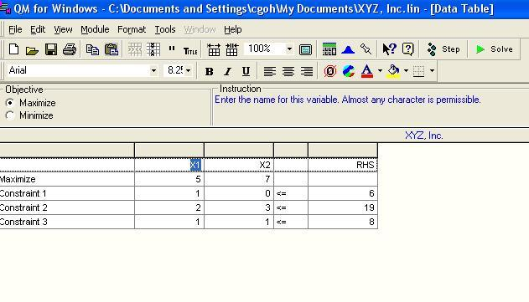
Computer Solutions: XYZ. Inc.
For MAN 321, we will use QM for Windows
Spreadsheet Showing Problem Data

Slide 23
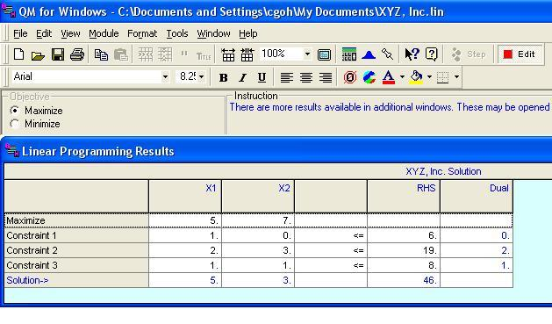
Computer Solutions: XYZ. Inc.
Spreadsheet Showing Solution

Slide 24
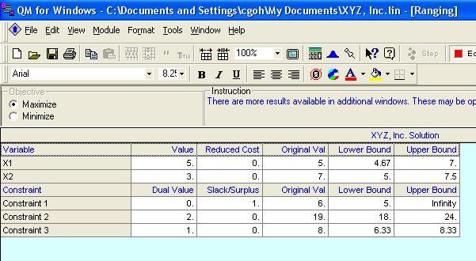
Computer Solutions: XYZ. Inc.
Spreadsheet Showing Ranging
Note: Slacks/Surplus and Reduced Costs

