Slide 1
Chapter 2: Introduction to Linear Programming
Linear Programming Problem
Problem Formulation
A Simple Maximization Problem
Graphical Solution Procedure
Extreme Points and the Optimal Solution
Computer Solutions
A Simple Minimization Problem
Special Cases

Slide 2
Linear Programming (LP) Problem
Linear programming (LP) involves choosing a course of action when the mathematical model of the problem contains only linear functions.
(Note: Linear programming has nothing to do with computer programming.)
The maximization or minimization of some quantity is the objective in all linear programming problems.
All LP problems have constraints that limit the degree to which the objective can be pursued.

Slide 3
Linear Programming (LP) Terms
If both the objective function and the constraints are linear, the problem is referred to as a linear programming problem.
Linear functions are functions in which each variable appears in a separate term raised to the first power and is multiplied by a constant (which could be 0).
Linear constraints are linear functions that are restricted to be "less than or equal to", "equal to", or "greater than or equal to" a constant.
A feasible solution satisfies all the problem's constraints.
An optimal solution is a feasible solution that results in the largest possible objective function value when maximizing (or smallest when minimizing).
A graphical solution method can be used to solve a linear program with two variables.

Slide 4
Guidelines for Model Formulation
Problem formulation or modeling is the process of translating a verbal statement of a problem into a mathematical statement.
Understand the problem thoroughly.
Describe the objective.
Describe each constraint.
Define the decision variables.
Write the objective in terms of the decision variables.
Write the constraints in terms of the decision variables.
Note: Formulating models is an art that can only be mastered with practice and experience. Every LP problems has some unique features, but most problems also have common features.

Slide 5
LP Formulation: XYZ, Inc.
XYZ, Inc. manufactures two products, namely
Product 1 and Product 2. The profits for Products 1 and 2 are $5 and $7 per unit, respectively. Due to demand limitations XYZ, Inc. should not produce more than 6 units of Product 1. Both products are made from steel and wood. Product 1 needs 2 pounds of steel and 1 cubic foot of wood, while Product 2 needs to 3 pounds of steel and 1 cubic foot of wood. Currently XYZ, inc. has 19 pounds of steel and 8 cubic feet of wood. Formulate the problem above and determine the optimal solution.
Describe the objective.
Describe each constraint.
Define the decision variables.

Slide 6
Example: XYZ, Inc.
Mathematical Model
  Define the decision variables
x₁ = number of units of Product 1 to produce
x₂ = number of units of Product 2 to produce
  Objective: Maximize profit
  Maximize: 5x₁ + 7x₂
  Constraint 1: Demand limitation of product 1
x₁ < 6

Slide 7
Example: XYZ, Inc. (Continued)
Mathematical Model
  Constraint 2: Steel Limitation
2x₁ + 3x₂ < 19
  Constraint 3: Wood Limitation
  x₁ + x₂ < 8
  Cannot produce negative units of
  products 1 and 2
    x₁ > 0 and x₂ > 0.

Slide 8
XYZ, Inc.: A Simple Maximization Problem
LP Formulation
Objective
Function
Max 5x₁ + 7x₂
s.t. x₁ < 6
2x₁ + 3x₂ < 19
x₁ + x₂ < 8
x₁ > 0 and x₂ > 0
“Regular”
Constraints
Non-negativity
Constraints

Slide 9
Example 1: Graphical Solution
First Constraint Graphed
x₂
8
7
6
5
4
3
2
1
x₁ = 6 (1: Product 1 Demand)
Shaded region
contains all
feasible points
for this constraint
(6, 0)
x₁
1 2 3 4 5 6 7 8 9 10

Slide 10
Example 1: Graphical Solution
Second Constraint Graphed
x₂
8
7
6
5
4
3
2
1
(0, 6 1/3)
2x₁ + 3x₂ = 19 (2: Steel)
Shaded
region contains
all feasible points
for this constraint
(9 1/2, 0)
x₁
1 2 3 4 5 6 7 8 9 10

Slide 11
Example 1: Graphical Solution
Third Constraint Graphed
x₂
(0, 8)
8
7
6
5
4
3
2
1
x₁ + x₂ = 8 (3: Wood)
Shaded
region contains
all feasible points
for this constraint
(8, 0)
x₁
1 2 3 4 5 6 7 8 9 10

Slide 12
Example 1: Graphical Solution
Feasible region: collection of points that satisfy ALL constraints
x₂
x₁ + x₂ = 8 (3: Wood)
8
7
6
5
4
3
2
1
x₁ = 6 (1: Demand)
Feasible
Region
2x₁ + 3x₂ = 19 (2: Steel)
x₁
1 2 3 4 5 6 7 8 9 10

Slide 13
Example 1: Graphical Solution
Objective Function Line
x₂
8
7
6
5
4
3
2
1
(0, 5)
Objective Function
5x₁ + 7x₂ = 35
(7, 0)
x₁
1 2 3 4 5 6 7 8 9 10

Slide 14
Example 1: Graphical Solution
Selected Objective Function Lines
x₂
8
7
6
5
4
3
2
1
5x₁ + 7x₂ = 35
5x₁ + 7x₂ = 39
5x₁ + 7x₂ = 42
x₁
1 2 3 4 5 6 7 8 9 10

Slide 15
Example 1: Graphical Solution
Optimal Solution
x₂
x₂
x₁ + x₂ = 8 (3: Wood)
8
7
6
5
4
3
2
1
8
7
6
5
4
3
2
1
Maximum
Objective Function Line
5x₁ + 7x₂ = 46
Optimal Solution
(x₁ = 5, x₂ = 3)
x₁ = 6 (1: Demand)
Feasible
Region
2x₁ + 3x₂ = 19 (2: Steel)
x₁
x₁
1 2 3 4 5 6 7 8 9 10
1 2 3 4 5 6 7 8 9 10

Slide 16
Binding and Non-Binding Constraints
A Constraint is binding if its resource is completely used up (i.e., no slack).
Steel and wood constraints are binding.
Optimal Solution: (x₁ = 5, x₂ = 3)
2x₁ + 3x₂ < 19 (2: Steel) x₁ + x₂ < 8 (3: Wood)
2(5) + 3(3) = 19 5+3 = 8
A constraint is not binding is its resource is not completely used up.
Product 1 demand is not binding.
x₁ < 6 (1: Demand)
x₁ = 5 (One unit left over called a ‘slack’)

Slide 17
Summary of the Graphical Solution Procedure for Maximization Problems
Prepare a graph of the feasible solutions for each of the constraints.
Determine the feasible region that satisfies all the constraints simultaneously.
Draw an objective function line.
Move parallel objective function lines toward larger objective function values without entirely leaving the feasible region.
Any feasible solution on the objective function line with the largest value is an optimal solution.

Slide 18
Slack and Surplus Variables
A linear program in which all the variables are non-negative and all the constraints are equalities is said to be in standard form.
Standard form is attained by adding slack variables to "less than or equal to" constraints, and by subtracting surplus variables from "greater than or equal to" constraints.
Slack and surplus variables represent the difference between the left and right sides of the constraints.
Slack and surplus variables have objective function coefficients equal to 0.

Slide 19
Slack Variables (for < constraints)
Example 1 in Standard Form
Max 5x₁ + 7x₂ + 0s₁ + 0s₂ + 0s₃
s.t. x₁ + s₁ = 6
2x₁ + 3x₂ + s₂ = 19
x₁ + x₂ + s₃ = 8
x₁, x₂ , s₁ , s₂ , s₃ > 0
s₁ , s₂ , and s₃
are slack variables

Slide 20
Slack Variables
Optimal Solution
x₂
Third
Constraint:
x₁ + x₂ = 8
First
Constraint:
x₁ = 6
8
7
6
5
4
3
2
1
s₃ = 0
s₁ = 1
Second
Constraint:
2x₁ + 3x₂ = 19
Optimal
Solution
(x₁ = 5, x₂ = 3)
s₂ = 0
x₁
1 2 3 4 5 6 7 8 9 10

Slide 21
Extreme Points and the Optimal Solution
The corners or vertices of the feasible region are referred to as the extreme points.
An optimal solution to an LP problem can be found at an extreme point of the feasible region.
When looking for the optimal solution, you do not have to evaluate all feasible solution points.
You have to consider only the extreme points of the feasible region.

Slide 22
Example 1: Extreme Points
x₂
8
7
6
5
4
3
2
1
5
(0, 6 1/3)
4
(5, 3)
Feasible
Region
(6, 2)
3
1
(0, 0)
2
(6, 0)
x₁
1 2 3 4 5 6 7 8 9 10

Slide 23
Interpretation of Computer Output
LP problems involving 1000s of variables and 1000s of constraints are now routinely solved with computer packages. Linear programming solvers are now part of many spreadsheet packages, such as Microsoft Excel.
In this chapter we will discuss the following output:
  objective function value
  values of the decision variables
  slack and surplus
In the next chapter we will discuss how an optimal solution is affected by a change in:
  a coefficient of the objective function
  the right-hand side value of a constraint
  reduced costs

Slide 24
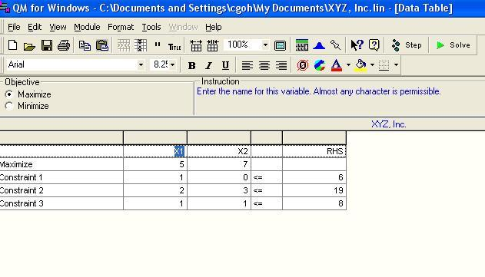
Computer Solutions: XYZ. Inc.
For MAN 321, we will use QM for Windows
Spreadsheet Showing Problem Data

Slide 25
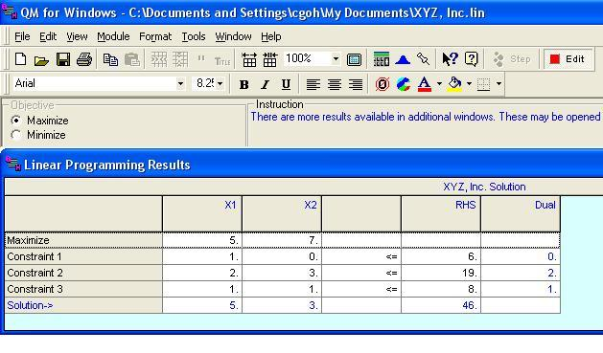
Computer Solutions: XYZ. Inc.
Spreadsheet Showing Solution

Slide 26
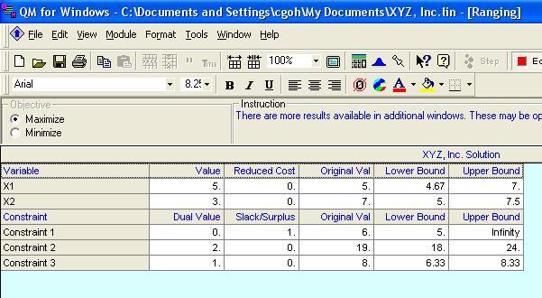
Computer Solutions: XYZ. Inc.
Spreadsheet Showing Ranging
Note: Slacks/Surplus and Reduced Costs

Slide 27
Example 1: Spreadsheet Solution
Interpretation of Computer Output
  We see from the Slides 24 and 25 that:
  Objective Function Value = 46
  Decision Variable #1 (x₁) = 5
  Decision Variable #2 (x₂) = 3
  Slack in Constraint #1 = 6 – 5 = 1
  Slack in Constraint #2 = 19 – 19 = 0
  Slack in Constraint #3 = 8 – 8 = 0

Slide 28
Example 2: A Simple Minimization Problem
LP Formulation
Min 5x₁ + 2x₂
s.t. 2x₁ + 5x₂ > 10 (1)
4x₁ − x₂ > 12 (2)
x₁ + x₂ > 4 (3)
x₁, x₂ > 0

Slide 29
Example 2: Graphical Solution
Graph the Constraints
Constraint 1: When x₁ = 0, then x₂ = 2; when x₂ = 0, then x₁ = 5. Connect (5,0) and (0,2). The ">" side is above this line.
Constraint 2: When x₂ = 0, then x₁ = 3. But setting x₁
to 0 will yield x₂ = -12, which is not on the graph. Thus, to get a second point on this line, set x₁ to any number larger than 3 and solve for x₂: when
x₁ = 5, then x₂ = 8. Connect (3,0) and (5,8). The ">“
side is to the right.
Constraint 3: When x₁ = 0, then x₂ = 4; when x₂ = 0, then x₁ = 4. Connect (4,0) and (0,4). The ">" side is above this line.

Slide 30
Example 2: Graphical Solution
Constraints Graphed
x₂
6
5
4
3
2
1
Feasible Region
4x₁ − x₂ > 12 (2)
x₁ + x₂ > 4 (3)
2x₁ + 5x₂ > 10 (1)
x₁
1 2 3 4 5 6

Slide 31
Example 2: Graphical Solution
Graph the Objective Function
Set the objective function equal to an arbitrary constant (say 20) and graph it. For 5x₁ + 2x₂ = 20, when x₁ = 0, then x₂ = 10; when x₂= 0, then x₁ = 4. Connect (4,0) and (0,10).
Move the Objective Function Line Toward Optimality
Move it in the direction which lowers its value (down), since we are minimizing, until it touches the last point of the feasible region, determined by the last two constraints.

Slide 32
Example 2: Graphical Solution
Objective Function Graphed
x₂
Min 5x₁ + 2x₂
6
5
4
3
2
1
4x₁ − x₂ > 12 (2)
x₁ + x₂ > 4 (3)
2x₁ + 5x₂ > 10 (1)
x₁
1 2 3 4 5 6

Slide 33
Example 2: Graphical Solution
Solve for the Extreme Point at the Intersection of the Two Binding Constraints
4x₁ - x₂ = 12
x₁+ x₂ = 4
Adding these two equations gives:
5x₁ = 16 or x₁ = 16/5
Substituting this into x₁ + x₂ = 4 gives: x₂ = 4/5
Solve for the Optimal Value of the Objective Function
5x₁ + 2x₂ = 5(16/5) + 2(4/5) = 88/5

Slide 34
Example 2: Graphical Solution
Optimal Solution
x₂
6
5
4
3
2
1
4x₁ − x₂ > 12 (2)
x₁ + x₂ > 4 (3)
Optimal Solution:
x₁ = 16/5, x₂ = 4/5,
5x₁ + 2x₂ = 17.6
2x₁ + 5x₂ > 10 (1)
x₁
1 2 3 4 5 6

Slide 35
Summary of the Graphical Solution Procedure
for Minimization Problems
Prepare a graph of the feasible solutions for each of the constraints.
Determine the feasible region that satisfies all the constraints simultaneously.
Draw an objective function line.
Move parallel objective function lines toward smaller objective function values without entirely leaving the feasible region.
Any feasible solution on the objective function line with the smallest value is an optimal solution.

Slide 36
Surplus Variables
Example 2 in Standard Form
Min 5x₁ + 2x₂ + 0s₁ + 0s₂ + 0s₃
s.t. 2x₁ + 5x₂ − s₁ = 10
4x₁ − x₂ − s₂ = 12
x₁ + x₂ − s₃ = 4
x₁, x₂, s₁, s₂, s₃ > 0
s₁ , s₂ , and s₃ are
surplus variables

Slide 37
Example 2: Spreadsheet Solution
Interpretation of Computer Output
  Objective Function Value = 17.6
  Decision Variable #1 (x₁) = 3.2
  Decision Variable #2 (x₂) = 0.8
  Surplus in Constraint #1 = 10.4 − 10 = 0.4
  Surplus in Constraint #2 = 12.0 − 12 = 0.0
  Surplus in Constraint #3 = 4.0 − 4 = 0.0

Slide 38
Types of Possible LP Solutions
  Unique Optimal Solution
  Alternative Optimal Solutions
  In the graphical method, if the objective function line is parallel to a boundary constraint in the direction of optimization, there are alternate optimal solutions, with all points on this line segment being optimal.
  Infeasible Solution
  No solution to the LP problem satisfies all the constraints. Graphically, this means a feasible region does not exist.
  Unbounded Solution.
  The objective function that can be increased without bound (i.e., unbounded solution) for maximization problem.

Slide 39
A) Alternative Optimal Solutions
Consider the following LP problem.
Max 4x₁ + 6x₂
s.t. x₁ < 6 (1)
2x₁ + 3x₂ < 18 (2)
x₁ + x₂ < 7 (3)
x₁ > 0 and x₂ > 0

Slide 40
Alternative Optimal Solutions (Cont.)
Boundary constraint 2x₁ + 3x₂ < 18 and objective function Max 4x₁ + 6x₂ are parallel. All points on line segment A – B are optimal solutions.
x₂
x₁ + x₂ < 7 (3)
7
6
5
4
3
2
1
Max 4x₁ + 6x₂
A
B
x₁ < 6 (1)
2x₁ + 3x₂ < 18 (2)
x₁
1 2 3 4 5 6 7 8 9 10

Slide 41
B) Infeasible Problem
  Causes include:
    A formulation error has been made.
    Management’s expectations are too high.
    Too many restrictions have been placed on the problem (i.e. the problem is over-constrained).
Consider the following LP problem.
Max 2x₁ + 6x₂
s.t. 4x₁ + 3x₂ < 12 (1)
2x₁ + x₂ > 8 (2)
x₁, x₂ > 0

Slide 42
Infeasible Problem (Cont.)
There are no points that satisfy both constraints, so there is no feasible region (and no feasible solution).
x₂
10
2x₁ + x₂ > 8 (2)
8
6
4x₁ + 3x₂ < 12 (1)
4
2
x₁
2 4 6 8 10

Slide 43
C) Unbounded Solution
  For real problems, this is the result of improper formulation. (Quite likely, a constraint has been inadvertently omitted.)
Consider the following LP problem.
Max 4x₁ + 5x₂
s.t. x₁ + x₂ > 5 (1)
3x₁ + x₂ > 8 (2)
x₁, x₂ > 0

Slide 44
Unbounded Solution (Cont.)
The feasible region is unbounded and the objective function line can be moved outward from the origin without bound, infinitely increasing the objective function.
x₂
10
3x₁ + x₂ > 8 (2)
8
6
Max 4x₁ + 5x₂
4
x₁ + x₂ > 5 (1)
2
x₁
2 4 6 8 10

